Slide 1



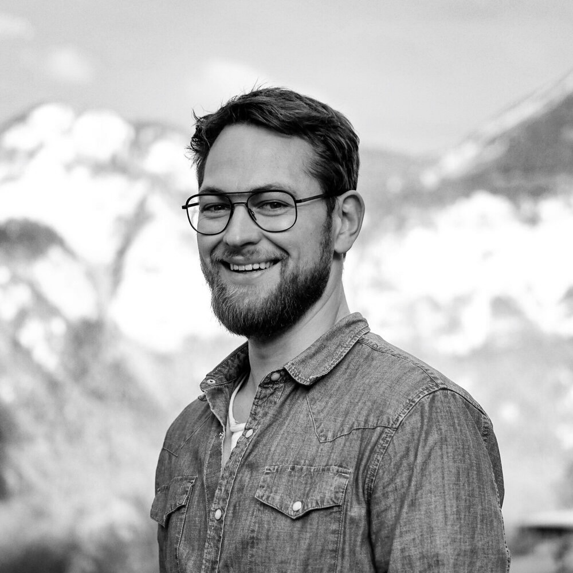
Alexander Langguth – Mission Lead
Professional experience
Education and skills
4 years at McKinsey & Company, Zurich with responsibility up to Project Manager level, mainly focusing on public/ social, electrical power, pharmaceuticals and manufacturing sector work in Europe and Sub-Saharan Africa, e.g.
Country electrification – Developed strategic initiatives for a national electric power utility of a sub-Saharan African country to improve access to electricity, reduce energy outages and minimize electric grid losses and delivered impact by setting up, training and leading a delivery team
Electric utility procurement – Supported a large African electric power utility to deliver procurement savings by developing and implementing a contract negotiations approach
Social business model – Developed a self-sustaining social business model for a leading pharmaceuticals company to market pharmaceuticals in rural India
Policy setting – Supported the government of a Middle Eastern country to develop a tariff policy that enables GDP diversification and industrial growth
Start-up growth strategy – Reviewed the business model of an advanced electronics start-up and recommended a strategy to boost growth
1 year at the Center for Sustainable Finance and Private Wealth (CSP) as the Head of Strategy and Partnerships, responsible for building a team that connects research, industry and private investors in order to drive positive social and environmental impact
Alexander worked as researcher at ETH Zürich investigating the diffusion of energy efficient technologies in residential buildings and innovation strategies for photovoltaic technologies
He holds a Master of Science degree in Strategic Management from HEC Lausanne, Switzerland with focus on Energy Economics and Sustainable Technologies
Alexander speaks German and English fluently and is able to have professional conversations in French
Introduction
I’m driven by the motivation to create positive social and environmental impact through the work I do and the life I live. I take my energy from the people around me, exploring everything that nature has to offer (mostly on high mountains) and loads of good coffee.

